Slide 1







BEACH LITTER
SEGMENTATION
GEOFFREY HINTON
13 September 2024

Slide 2



BACKGROUND
Based on data from Indonesia’s National Research and Innovation Agency (BRIN), there are 615,674 tonnes of plastic waste leaking into Indonesian waters. The litter on the beach has a negative impact on the environment.
The Indonesian government launched a National Action Plan to reduce marine plastic debris by 70% by 2025. As a result, from 2017 to 2022, Indonesia was able to reduce the leakage of plastic waste into the ocean by about 36%.
Despite the success in reducing the amount of leakage of litter into the ocean, there are still Indonesian beaches that are negatively highlighted by foreign media due to complaints from residents around the beach regarding the amount of litter after the rain for example Kuta beach in Bali, which had 30 tonnes of rubbish despite a clean-up.

Slide 3
BACKGROUND
One of the causes of the previous problem is that the monitoring of litter on Indonesian beaches still uses manual methods, which requires a lot of resources and time. So, systematic and innovative ways are needed to monitor litter on the beach in a more effective way.
Hence, in this study, an AI Computer Vision-based technology is proposed to segment objects on the beach, specifically natural litter and artificial litter. Several algorithms for object segmentation in this project are Resnet50-Unet and YOLOv8 segmentation models.

Slide 4



OBJECTIVES & MODELS
Objectives:
1. Obtain best segmentation model:
- Segment Natural Litter
- Segment Artificial Litter
2. Optimize best segmentation:
- Hyperparameter Tuning
Models:
Resnet50-UNet
YOLOv8 segmentation models:
- YOLOv8n
- YOLOv8s
- YOLOv8m
- YOLOv8l
- YOLOv8x
Priority: Prediction Accuracy over Inference Time
Accuracy
Speed

Slide 5



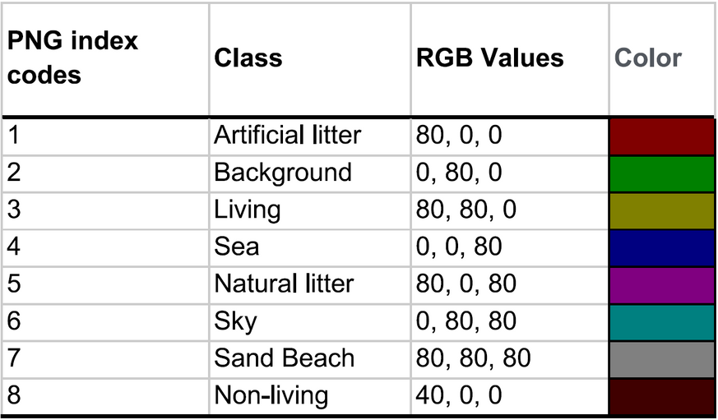
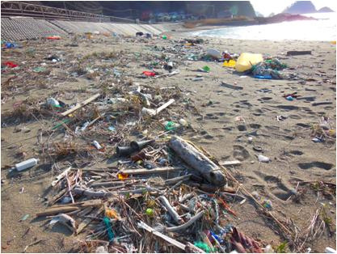
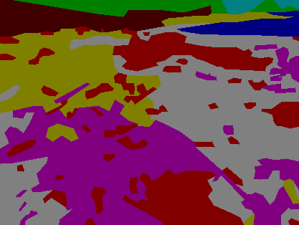
DATASET
This project uses a dataset from the Paper titled “Pixel-level image classification for detecting beach litter using a deep learning approach” by Hidoka, Matsuko. et al., 2022 consisting of 3,500 images, maskings, and labels. Classification of the masking part into 8 classes. with the following link:
[https://www.sciencedirect.com/science/article/abs/pii/S0025326X22000534]
Dataset Class Legend
Dataset Image Example
Dataset Mask Example

Slide 6


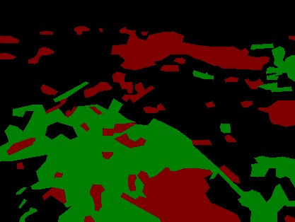
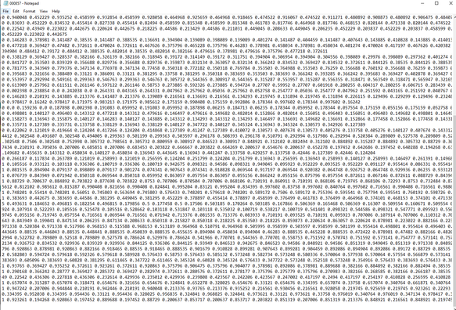




DATASET PREPARATION
Mask Pallete Changer
Mask to YOLO convertion
YOLO anno. txt
Reduce Class
Data Split
8 to 3 Classes: Background, Artificial litter, Natural litter
Divided into:
Train = 2,240 Images & labels
Validation = 560 Images & labels

Slide 7
PRELIMINARY MODEL STUDY
ResNet50_Unet | ResNet50_Unet
Parameters | Values
# of epoch | 20
Input width & height | 736, 544
Batch size | 2
Optimizer | Adam (lr = 0.0001)
Loss | cat. crossentropy
# of Classes | 8 & 3
YOLOv8-seg | YOLOv8-seg
Parameters | Values
# of epoch | 50
Input width & height | 736, 544
Batch size | 16
Optimizer | SGD (lr = 0.005)
Loss | Distributed focal loss
YOLOv8 variation | n, s, m, l, x

Slide 8
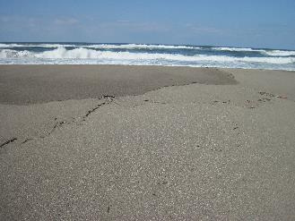
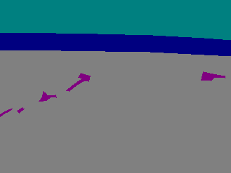
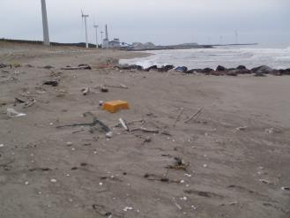
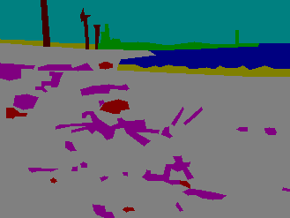
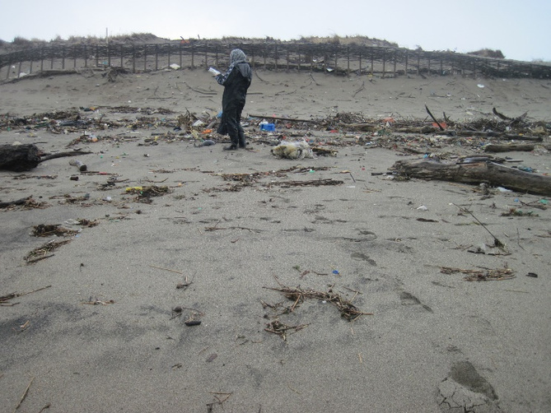
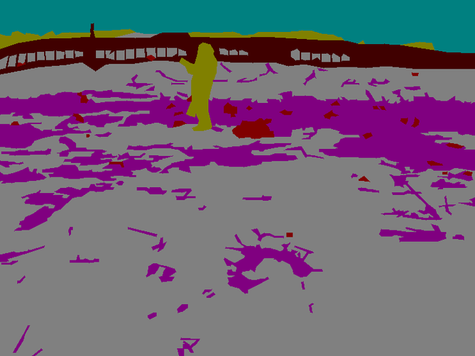
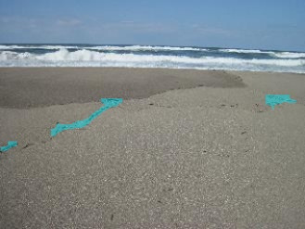
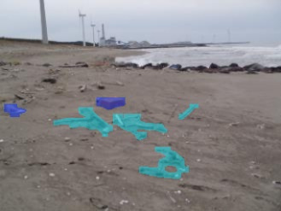
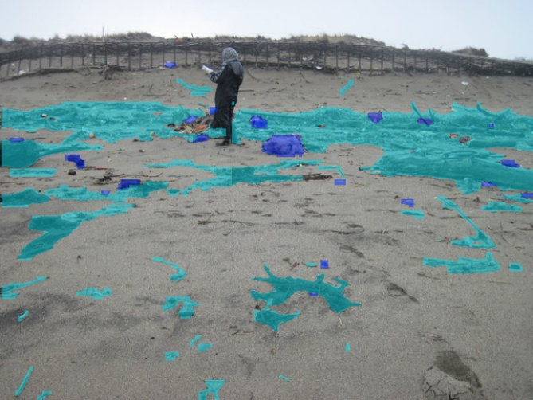
PRELIMINARY MODEL RESULTS : BEST MODEL
 | Test_Image 1 | Test_Image 2 | Test_Image 3
Original
YOLOv8x Pred.

Slide 9

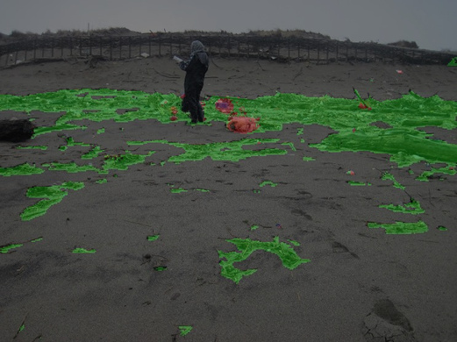
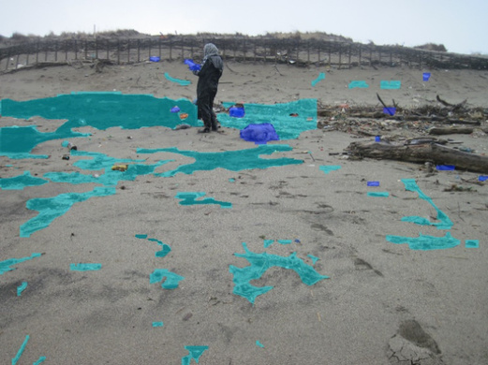
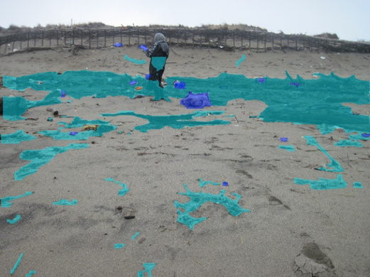
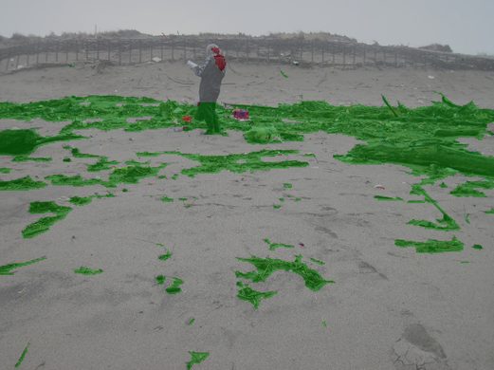
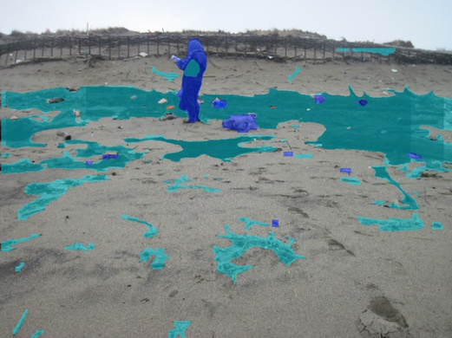
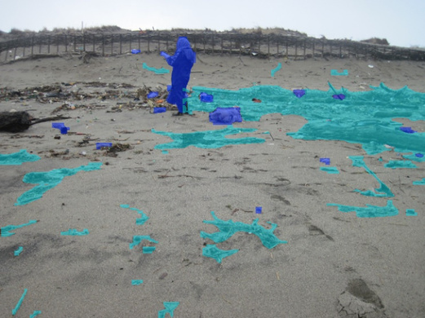
PRELIMINARY MODEL RESULTS : OTHER MODELS
 | YOLOv8x
ResNet50_ Unet 8 classes | YOLOv8n | YOLOv8m
ResNet50_ Unet 3 classes | YOLOv8s | YOLOv8l

Slide 10

MODEL FINETUNING
YOLOv8x Finetuning First Stage: | YOLOv8x Finetuning First Stage:
var | 1 | 2 | 3 | 4
Epoch | 70 | 70 | 70 | 70
Batchsize | 4 | 8 | 16 | 16
lr0 | 0.005 | 0.005 | 0.0005 | 0.05
optimizer | SGD | SGD | SGD | SGD
YOLOv8x Finetuning Second Stage: | YOLOv8x Finetuning Second Stage:
var | 1 | 2 | 3 | 4 | 5
Epoch | 50 | 50 | 50 | 50 | 50
Batchsize | 16 | 16 | 16 | 16 | 16
lr0 | 0.01 | 0.001 | 0.005 | 0.001 | 0.0005
optimizer | SGD | SGD | Adam | Adam | Adam

Slide 11
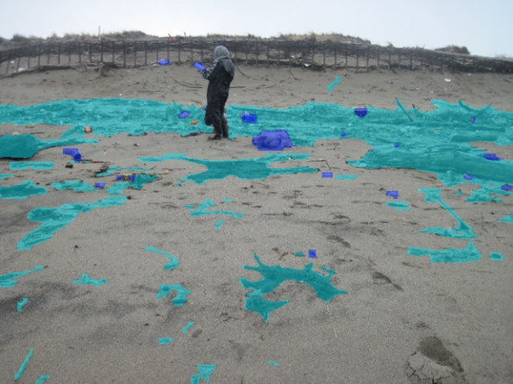
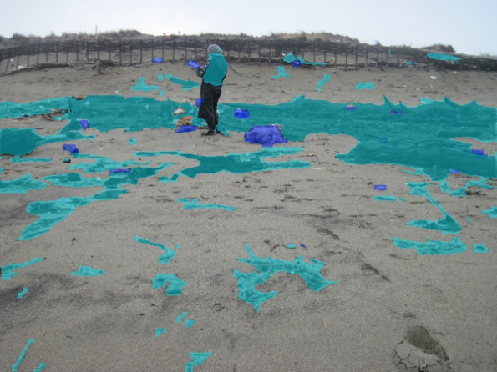
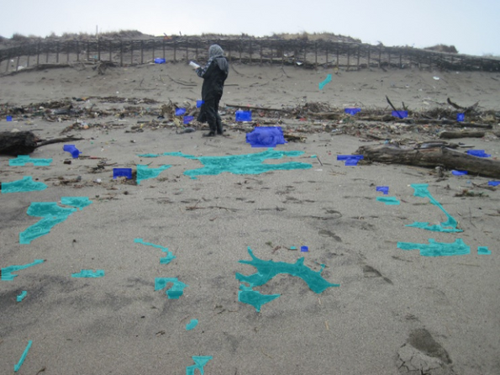
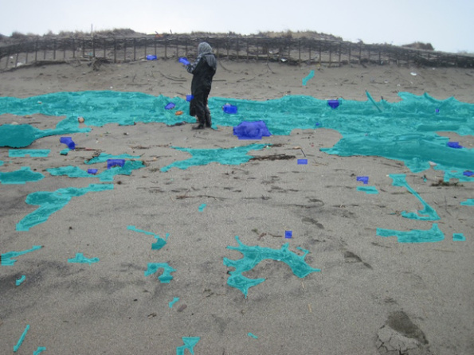
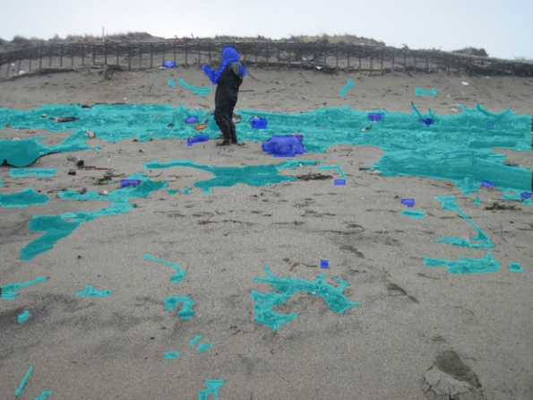
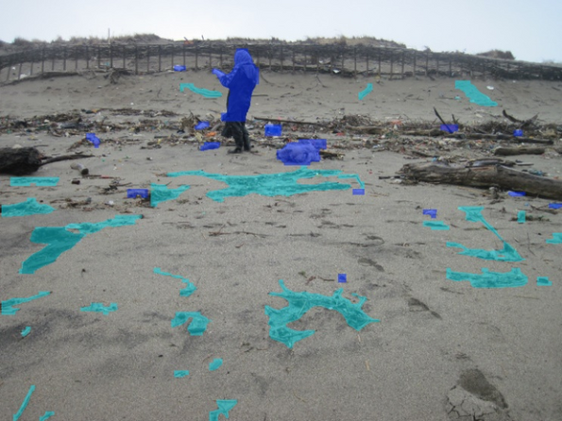
YOLOv8x FINETUNING RESULTS
 | Prelim. model LR 0.005 Batchsize 16 SGD
LR 0.0005 | Batchsize 4 | Adam
LR 0.001 | Batchsize 8 | Adam

Slide 12

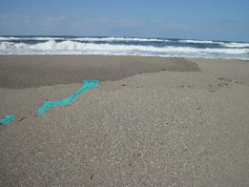
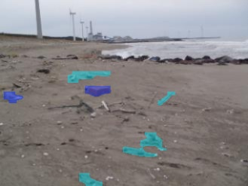

FINAL MODEL
 | Test_Image 1 | Test_Image 2 | Test_Image 3
Base Model
LR 0.001

Slide 13

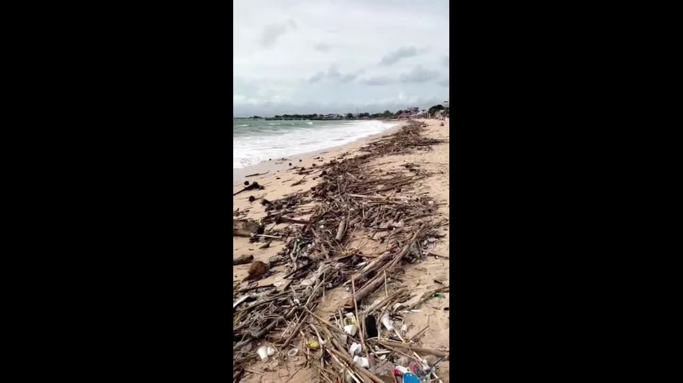
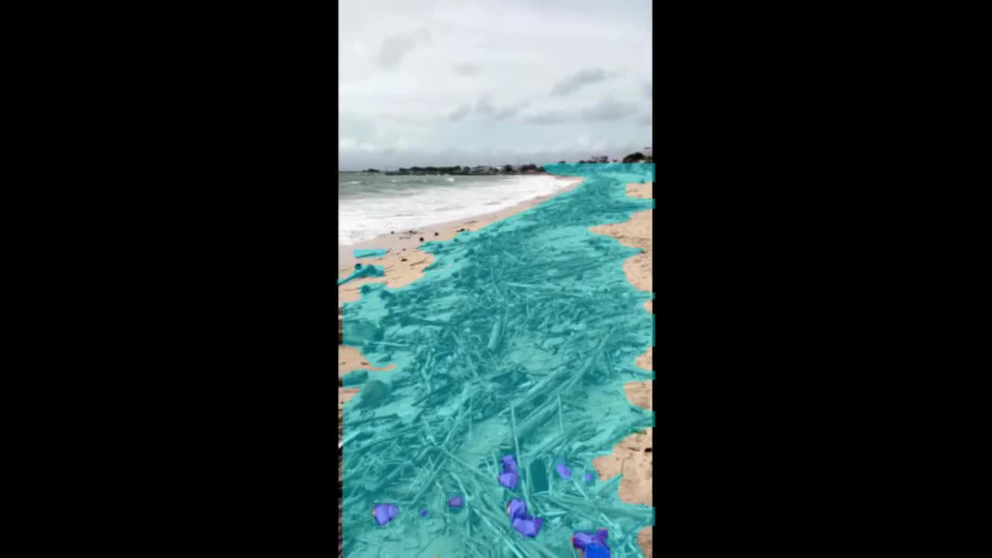



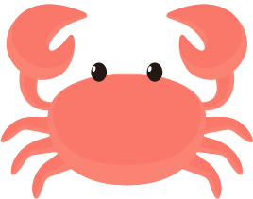
IMPLEMENTATION
https://huggingface.co/spaces/eurekalabdawara/beach-litter-segmentation-YOLOv8x

Slide 14
CONCLUSION
Based on the results of the study, YOLOv8x is best segmentation model that capable of segmenting natural and artificial litter on the beach.
Based on the hyperparameter tuning results, we conclude that:
The batch size affects the result of segmentation. Optimal results are achieved at batch size 16. Smaller batch sizes results in less optimal segmentation results.
Stochastic Gradient Descent (SGD) optimizer shows better results than Adam optimizer.
The best result is provided by a model trained within 50 epochs.
The learning Rate (LR) for the best results is 0.005.

Slide 15






FUTURE WORKS
Visualize detected litter quantity from image or video
Enhance dataset in terms of location and trash variation, utilize data from remote sensing such as drones and action camera, etc.

Slide 16








CV-D (Geoffrey Hinton) | CV-D (Geoffrey Hinton)
NAMA ANGGOTA | PENUGASAN
Calvin Christian Chandra (Team Leader) | Coding, pembuatan PPT
Satrio Fatturahman | Coding, pembuatan PPT
Shania Salsabilla | Coding, pembuatan PPT
Eureka Labdawara | Coding, pembuatan PPT
Alamul Yaqin | Coding, pembuatan PPT
THANK YOU
The brain sure as hell doesn't work by somebody programming in rules.
GEOFFREY HINTON

